Slide 1
Getting the Features for Problem-Solving ECE 4740/5740 Professor Hanna

Slide 2
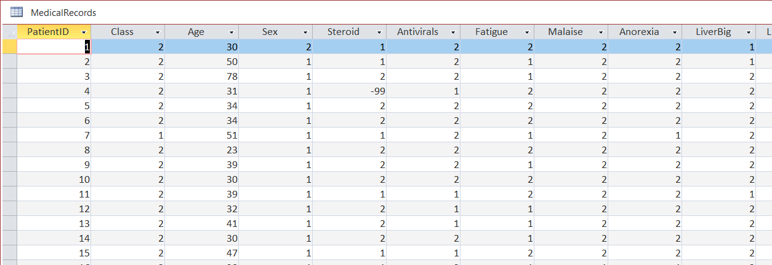
Data
Symptom & Medication Information
4. STEROID: 1 = no, 2 = yes
5. ANTIVIRALS: 1 = no, 2 = yes
6. FATIGUE: 1 = no, 2 = yes
7. MALAISE: 1 = no, 2 = yes
8. ANOREXIA: 1 = no, 2 = yes
9. LIVER BIG: 1 = no, 2 = yes
10. LIVER FIRM: 1 = no, 2 = yes
11. SPLEEN PALPABLE: 1 = no, 2 = yes
12. SPIDERS: 1 = no, 2 = yes
13. ASCITES: 1 = no, 2 = yes
14. VARICES: 1 = no, 2 = yes
Patient Information
0. PatientID (Primary Key)
1. ALIVE: 1 = DIE, 2 = LIVE
2. AGE: Number of years integer
3. SEX: 1 = male, 2 = female
Blood Tests for Certain Blood Characteristics
1. BILIRUBIN double
2. ALK PHOSPHATE double
3. SGOT double
4. ALBUMIN double

Slide 3
Data
Preprocessing
Remove invalid data
“Bin” or “Group”
Normalize data

Slide 4
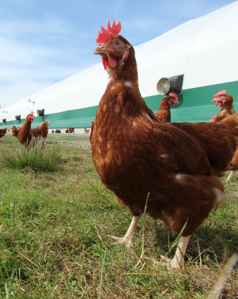
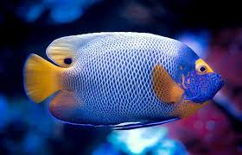
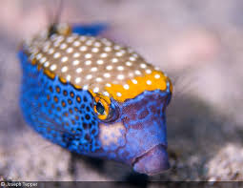
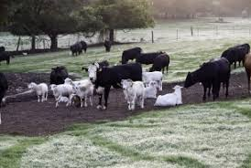
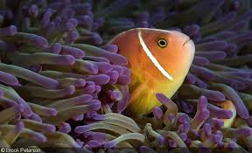

Images

Slide 5
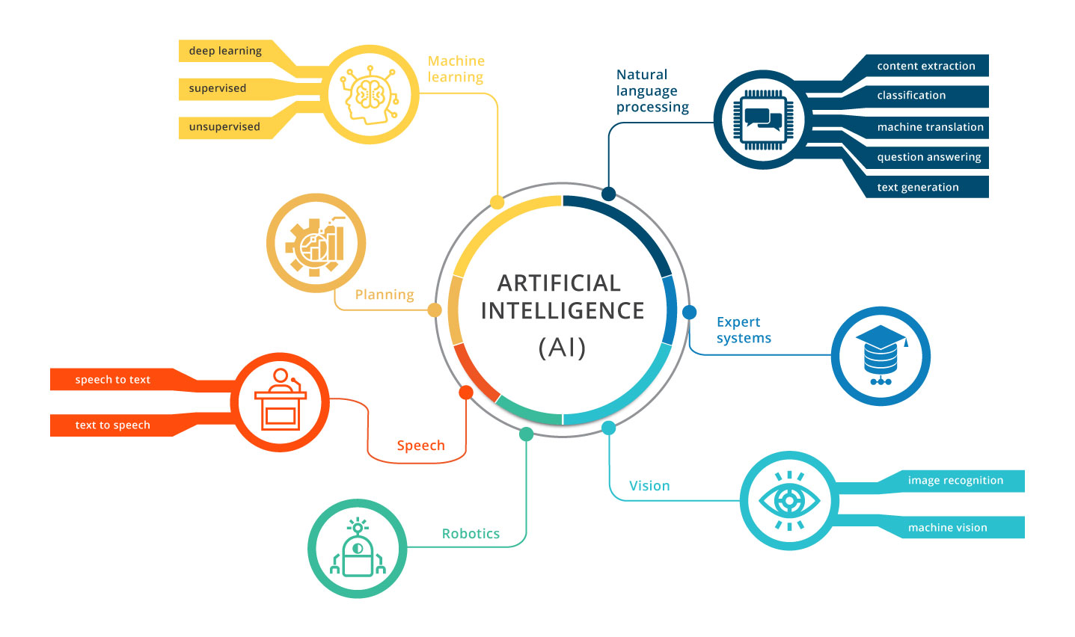
Artificial Intelligence

Slide 6
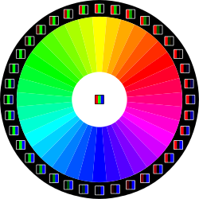
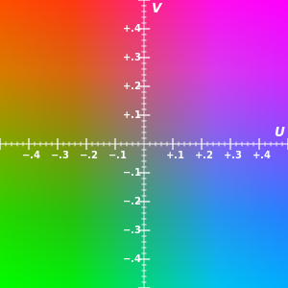
Preprocessing
Normalize Contrast and Lighting
Color Spaces or Grayscale
RGB, YUV, YIQ
Black and White

Slide 7
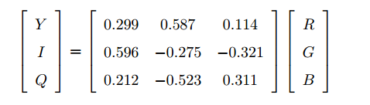
Preprocessing
RGB → YIQ
Y: Luminance, or brightness of the image. Colors increase in brightness as Y increases.
I: In-phase, which is approximately the amount of blue or orange tones in the image.
Q: Quadrature, which is approximately the amount of green or purple tones in the image.

Slide 8
Preprocessing
Let’s look at Lena in MATLAB
imread (RGB)
rgb2ntsc (YIQ)
rgb2ycbcr (YCbCr)

Slide 9
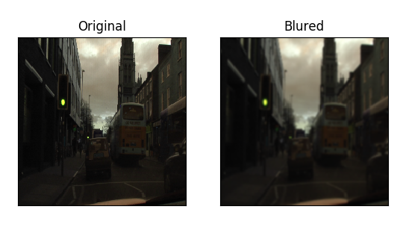
Preprocessing
Denoise
Resize
Object identification
Resize

Slide 10
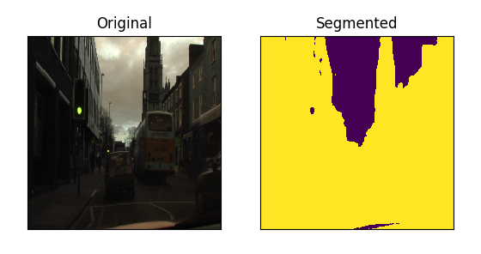
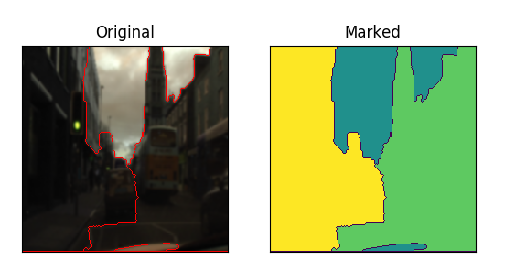
Preprocessing
Segmentation

Slide 11
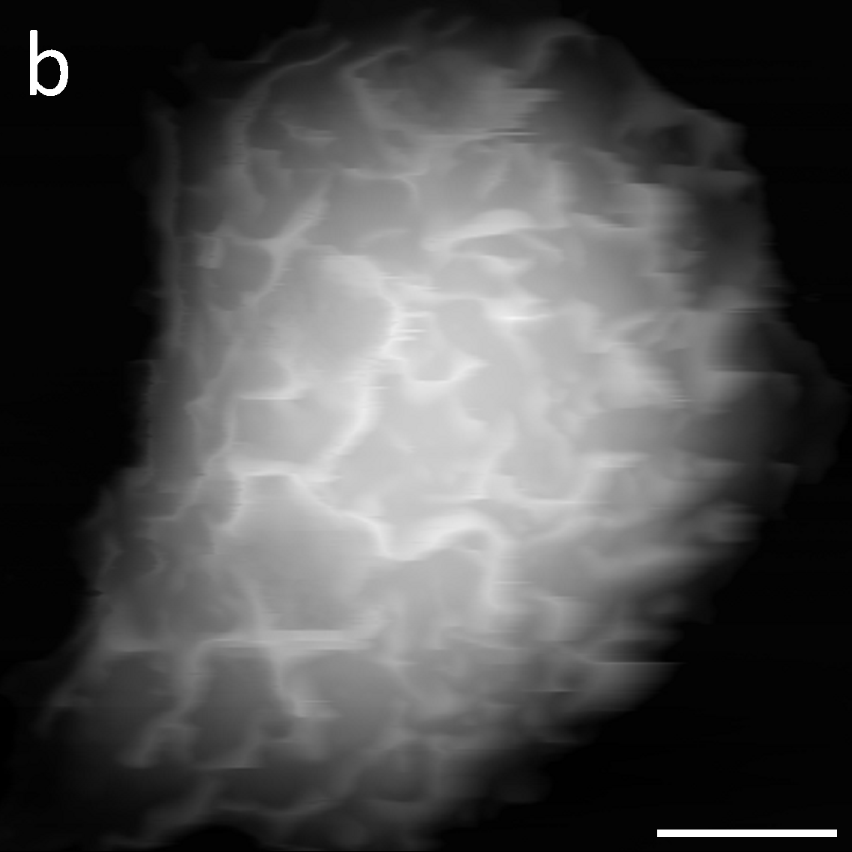
Preprocessing
Segmentation

Slide 12
Image Processing
2D Signal Processing = Image Processing
Filtering
Uses convolution in two dimensions
Pixels – grayscale 0 to 255
35 | 35 | 35 | 36 | 35 | 36 | 35 | 36 | 35 | 36
35 | 35 | 35 | 36 | 35 | 36 | 35 | 36 | 35 | 36
35 | 36 | 255 | 255 | 35 | 36 | 255 | 255 | 35 | 36
35 | 36 | 255 | 255 | 35 | 36 | 255 | 255 | 35 | 36
35 | 36 | 35 | 36 | 35 | 36 | 35 | 36 | 35 | 36
35 | 36 | 35 | 255 | 35 | 36 | 255 | 36 | 35 | 36
35 | 36 | 35 | 36 | 255 | 255 | 35 | 36 | 35 | 36
35 | 36 | 35 | 36 | 255 | 255 | 35 | 36 | 35 | 36

Slide 13
Image Processing
35 | 35 | 35 | 36 | 35 | 36 | 35 | 36 | 35 | 36
35 | 35 | 35 | 36 | 35 | 36 | 35 | 36 | 35 | 36
35 | 36 | 255 | 255 | 35 | 36 | 255 | 255 | 35 | 36
35 | 36 | 255 | 255 | 35 | 36 | 255 | 255 | 35 | 36
35 | 36 | 35 | 36 | 35 | 36 | 35 | 36 | 35 | 36
35 | 36 | 35 | 255 | 35 | 36 | 255 | 36 | 35 | 36
35 | 36 | 35 | 36 | 255 | 255 | 35 | 36 | 35 | 36
35 | 36 | 35 | 36 | 255 | 255 | 35 | 36 | 35 | 36
Filtering
Filter:
New Image
1/9 | 1/9 | 1/9
1/9 | 1/9 | 1/9
1/9 | 1/9 | 1/9
 | 60

Slide 14
Image Processing
35 | 35 | 35 | 36 | 35 | 36 | 35 | 36 | 35 | 36
35 | 35 | 35 | 36 | 35 | 36 | 35 | 36 | 35 | 36
35 | 36 | 255 | 255 | 35 | 36 | 255 | 255 | 35 | 36
35 | 36 | 255 | 255 | 35 | 36 | 255 | 255 | 35 | 36
35 | 36 | 35 | 36 | 35 | 36 | 35 | 36 | 35 | 36
35 | 36 | 35 | 255 | 35 | 36 | 255 | 36 | 35 | 36
35 | 36 | 35 | 36 | 255 | 255 | 35 | 36 | 35 | 36
35 | 36 | 35 | 36 | 255 | 255 | 35 | 36 | 35 | 36
Filtering
Filter:
New Image
1/9 | 1/9 | 1/9
1/9 | 1/9 | 1/9
1/9 | 1/9 | 1/9
 | 60 | 84

Slide 15
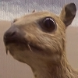
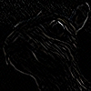
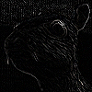
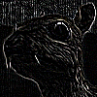
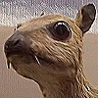



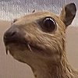
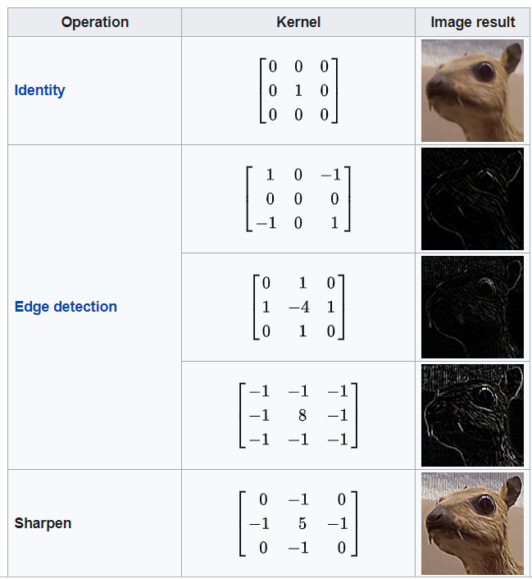
Image Processing

Slide 16
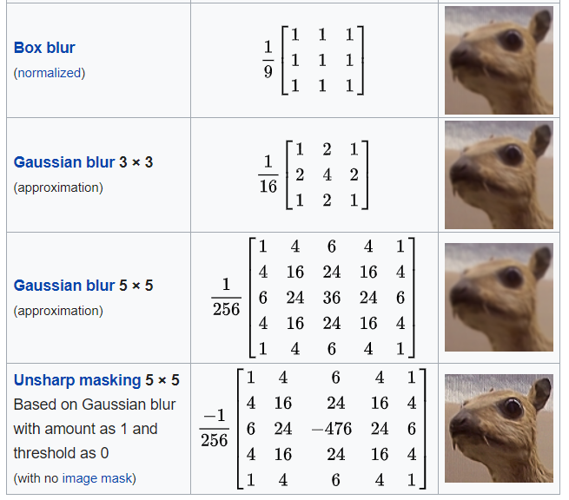
Image Processing

Slide 17
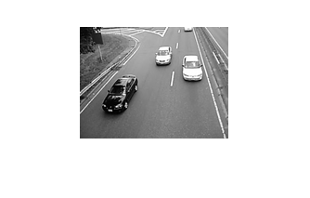
How can we identify the light cars in this camera feed?

Slide 18
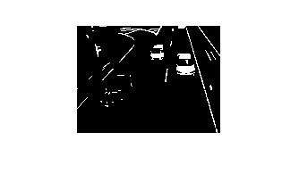

Edge Filter
Morphological
Operation - Erode

Slide 19
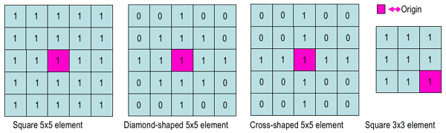
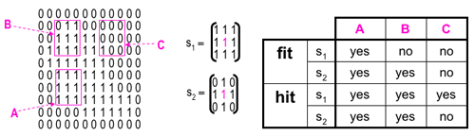
Morphological Operations
Structuring Elements – what size area on which to operate

Slide 20
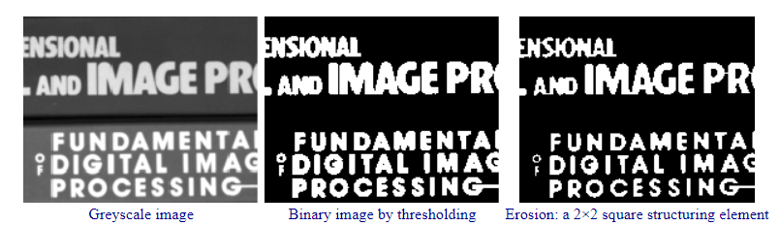
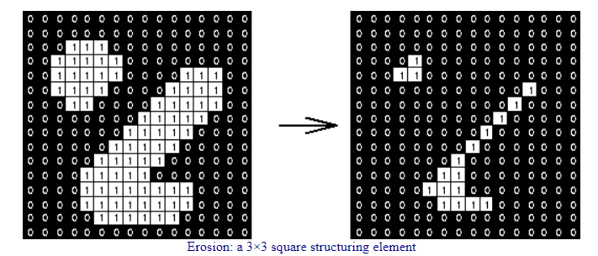
Morphological Operations
Erosion - Fits

Slide 21
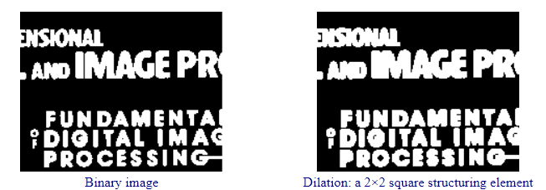
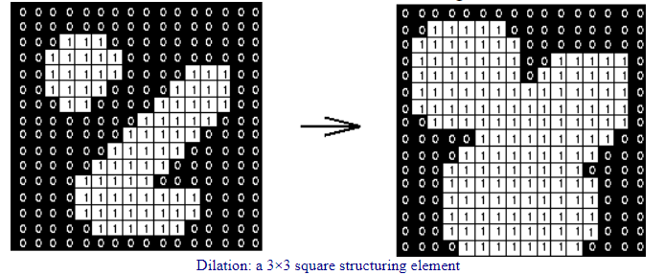
Morphological Operations
Dilation - Hits

Slide 22
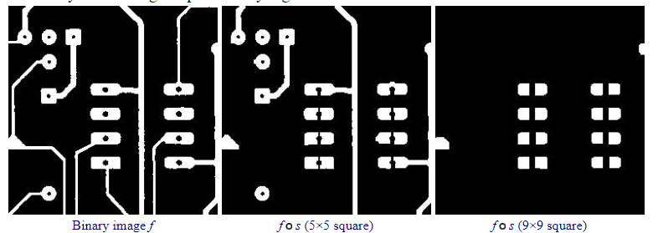
Morphological Operations
Opening
Erosion followed by a dilation

Slide 23
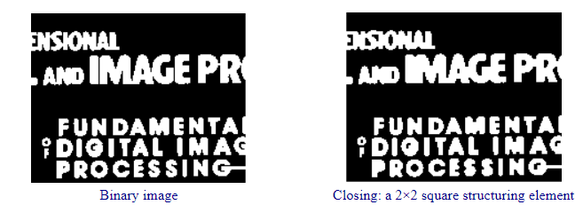
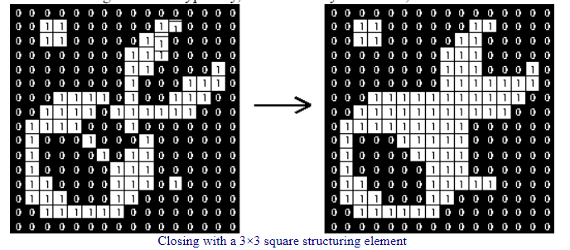
Morphological Operations
Closing
Dilation followed by an erosion

Slide 24
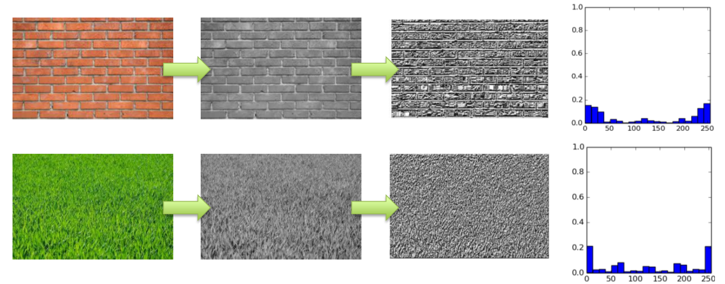
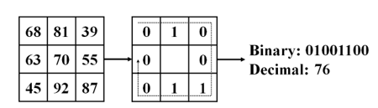
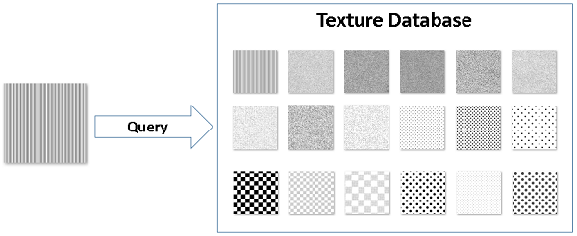
Morphological Operations
LBP – Local Binary Patterns
Textures

Slide 25
Morphological Operations
LBP – Local Binary Patterns
Histograms

Slide 26
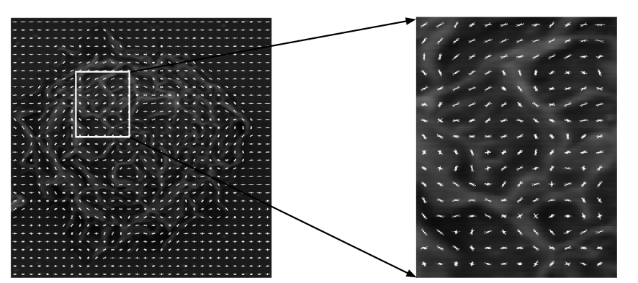
Morphological Operations
HOG – Histogram of Gradients
How many “angles” are there?
In local areas or overall

Slide 27
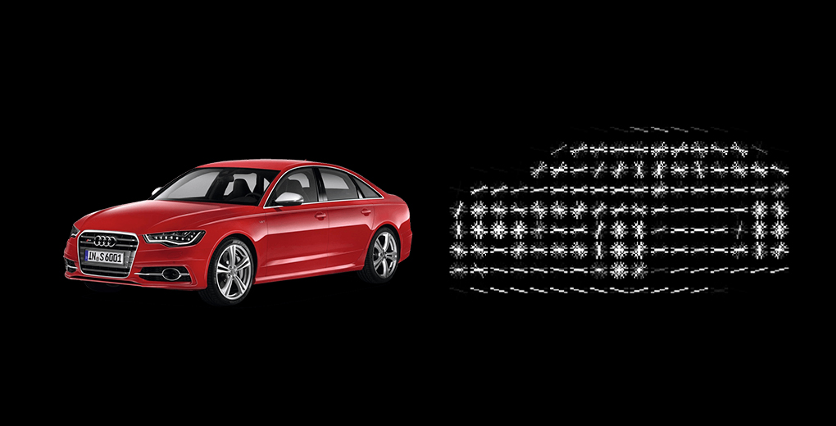
HOG

Slide 28
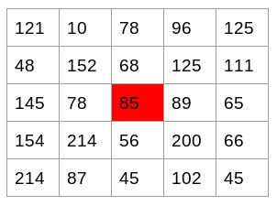
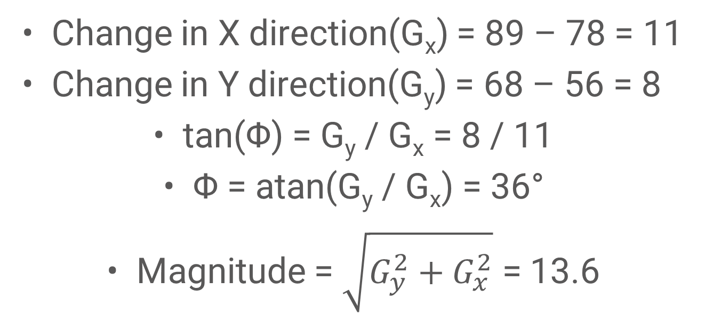
HOG
Change in X direction(G_{x}) = 89 – 78 = 11
Change in Y direction(G_{y}) = 68 – 56 = 8
tan(Φ) = G_{y} / G_{x} = 8 / 11
Φ = atan(G_{y} / G_{x}) = 36°
Magnitude = $\sqrt{G_{y}^{2}+G_{x}^{2}}$ = 13.6

Slide 29
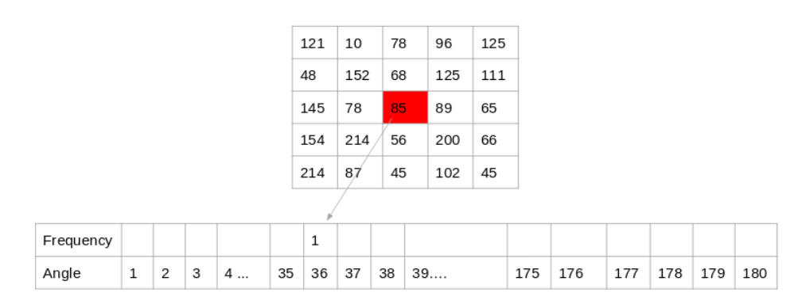
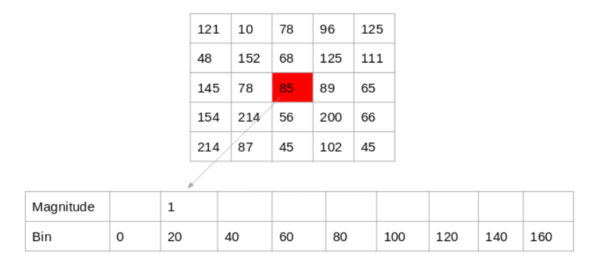
Histogram
13.6

Slide 30
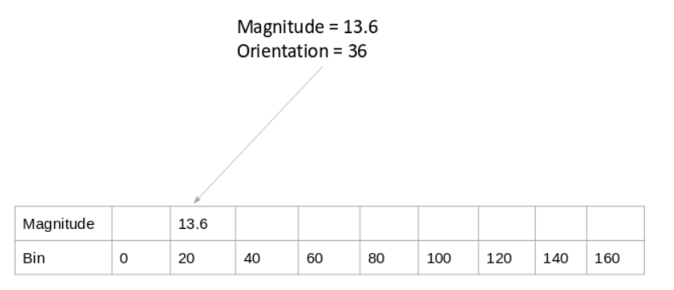
Histogram

Slide 31
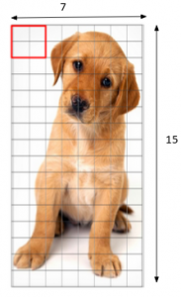
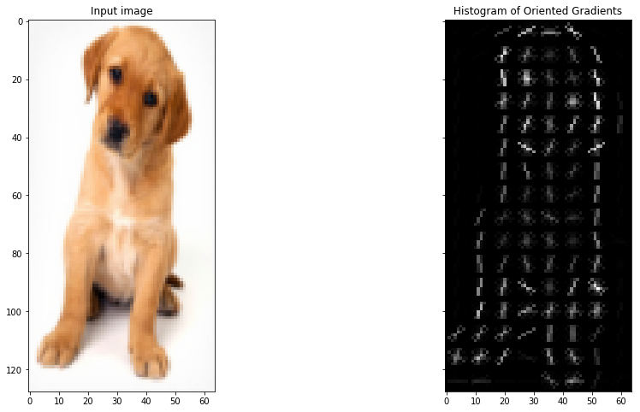
Segmented HOG

Slide 32
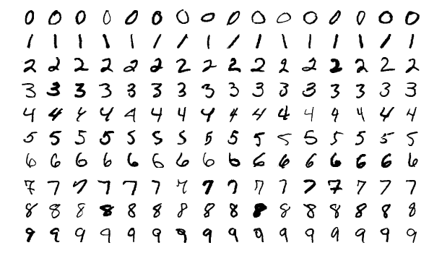
Character Recognition

Slide 33
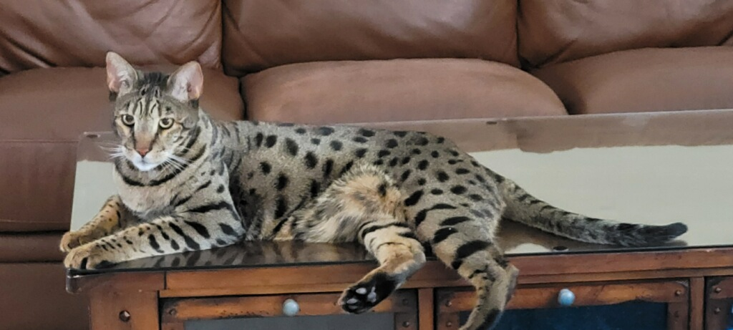


Slide 34

